Slide 1

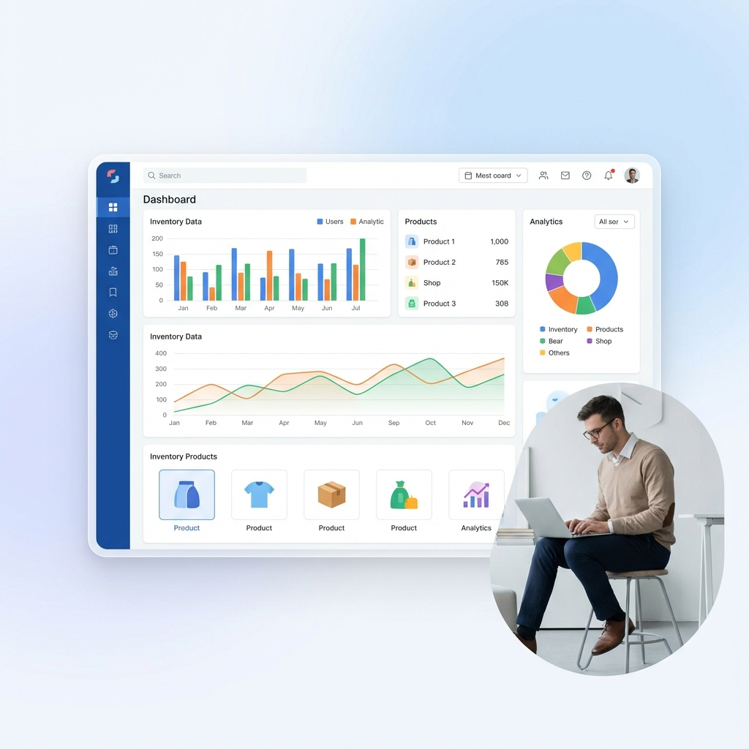
StockFlow
Inventory Management
for SMBs
€9/mo • 83% margins
€12B market • 15M customers

Slide 2


The Problem & Our Solution
📉 Problem
✅ Solution
• 60% lack systems
• 15% revenue lost
• €100-500/mo cost
✓ €9-19/mo only
✓ 2-min setup
✓ AI insights
StockFlow
2/5

Slide 3
Market & Business Model
€12B
TAM
€2.4B
SAM
€120M
SOM
€9/mo
Starter
€19/mo
Pro
€49/mo
Business
83% Margins • 12:1 LTV:CAC • Month 2 Break-even • <5% Churn
StockFlow
3/5

Slide 4
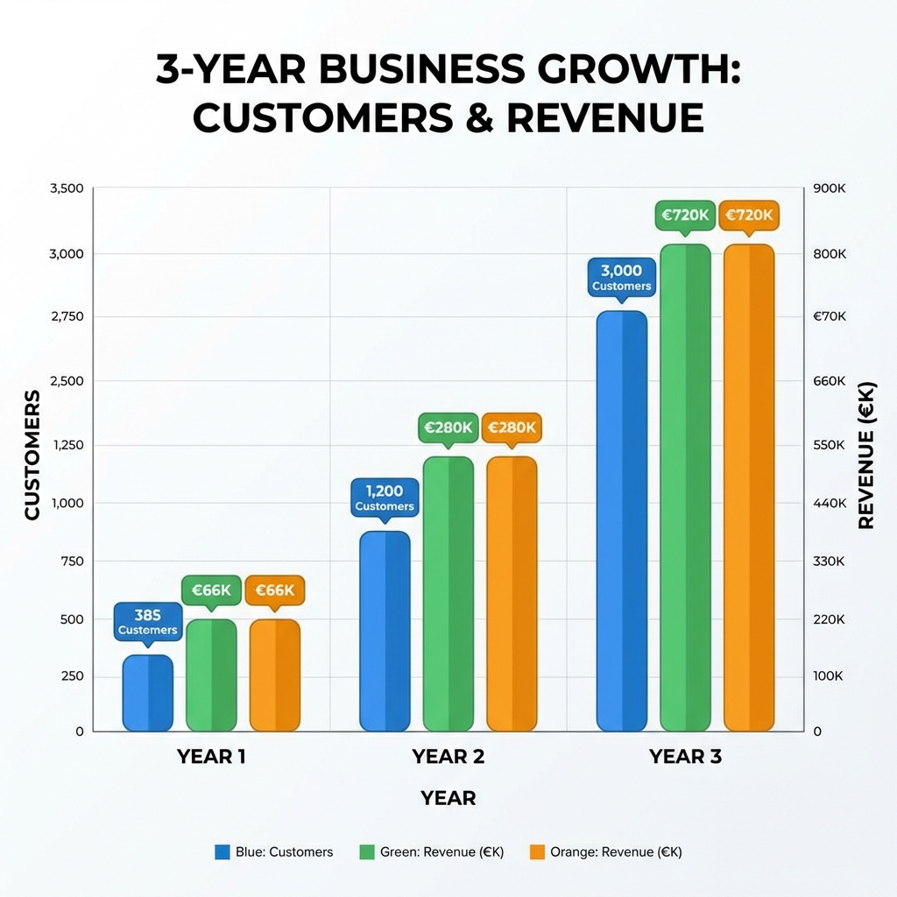
Growth & Advantage
Y1
385 customers
€66K ARR
Y2
1.2K customers
€280K ARR
Y3
3K customers
€720K ARR
🏆 91-98% Cheaper • Modern UX • 2-Min Setup • SMB-Focused
StockFlow
4/5

Slide 5
Investment Opportunity
Seeking €250K
for 12-15% Equity
40%
Product
€100K
40%
Marketing
€100K
20%
Operations
€50K
10-20x Return • Month 2 Break-even • €12B Market
📧 founders@stockflow.com • 🌐 www.stockflow.com
StockFlow
5/5

Slide 6
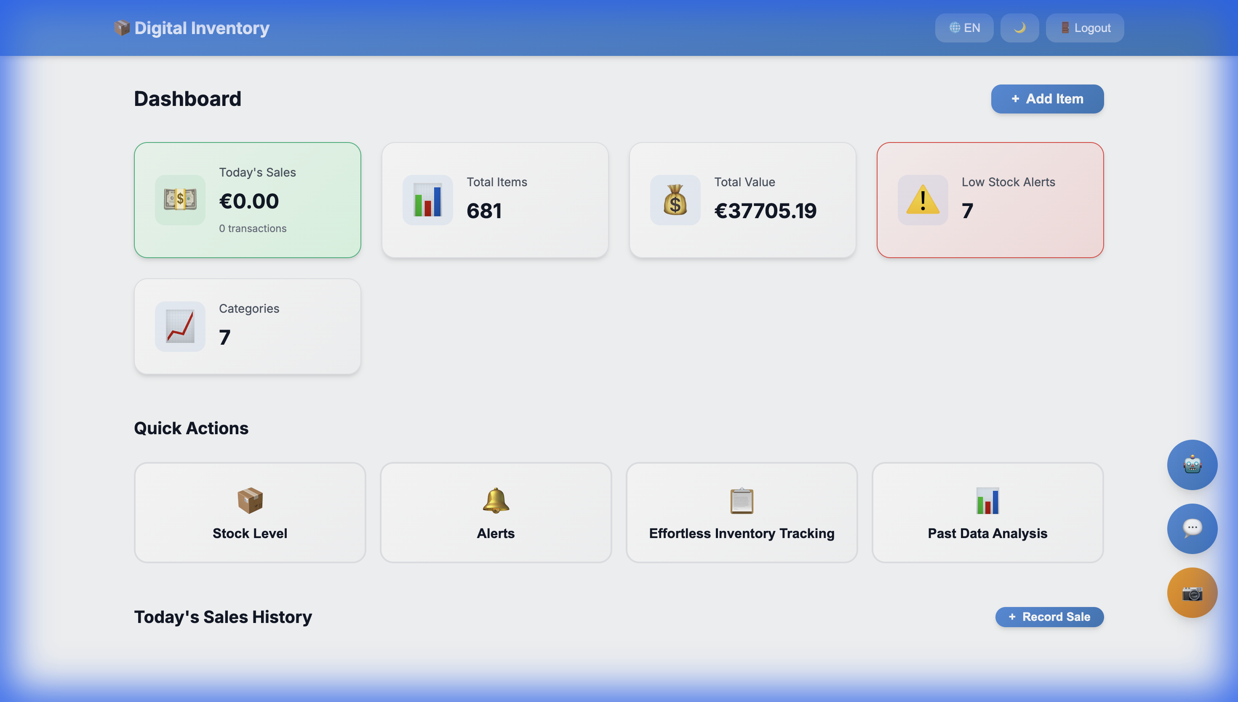
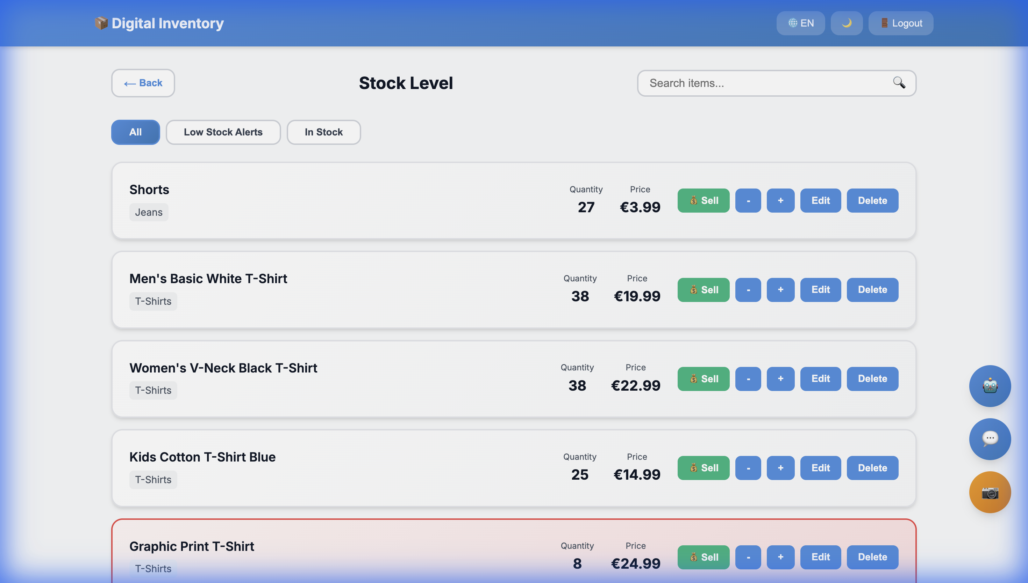
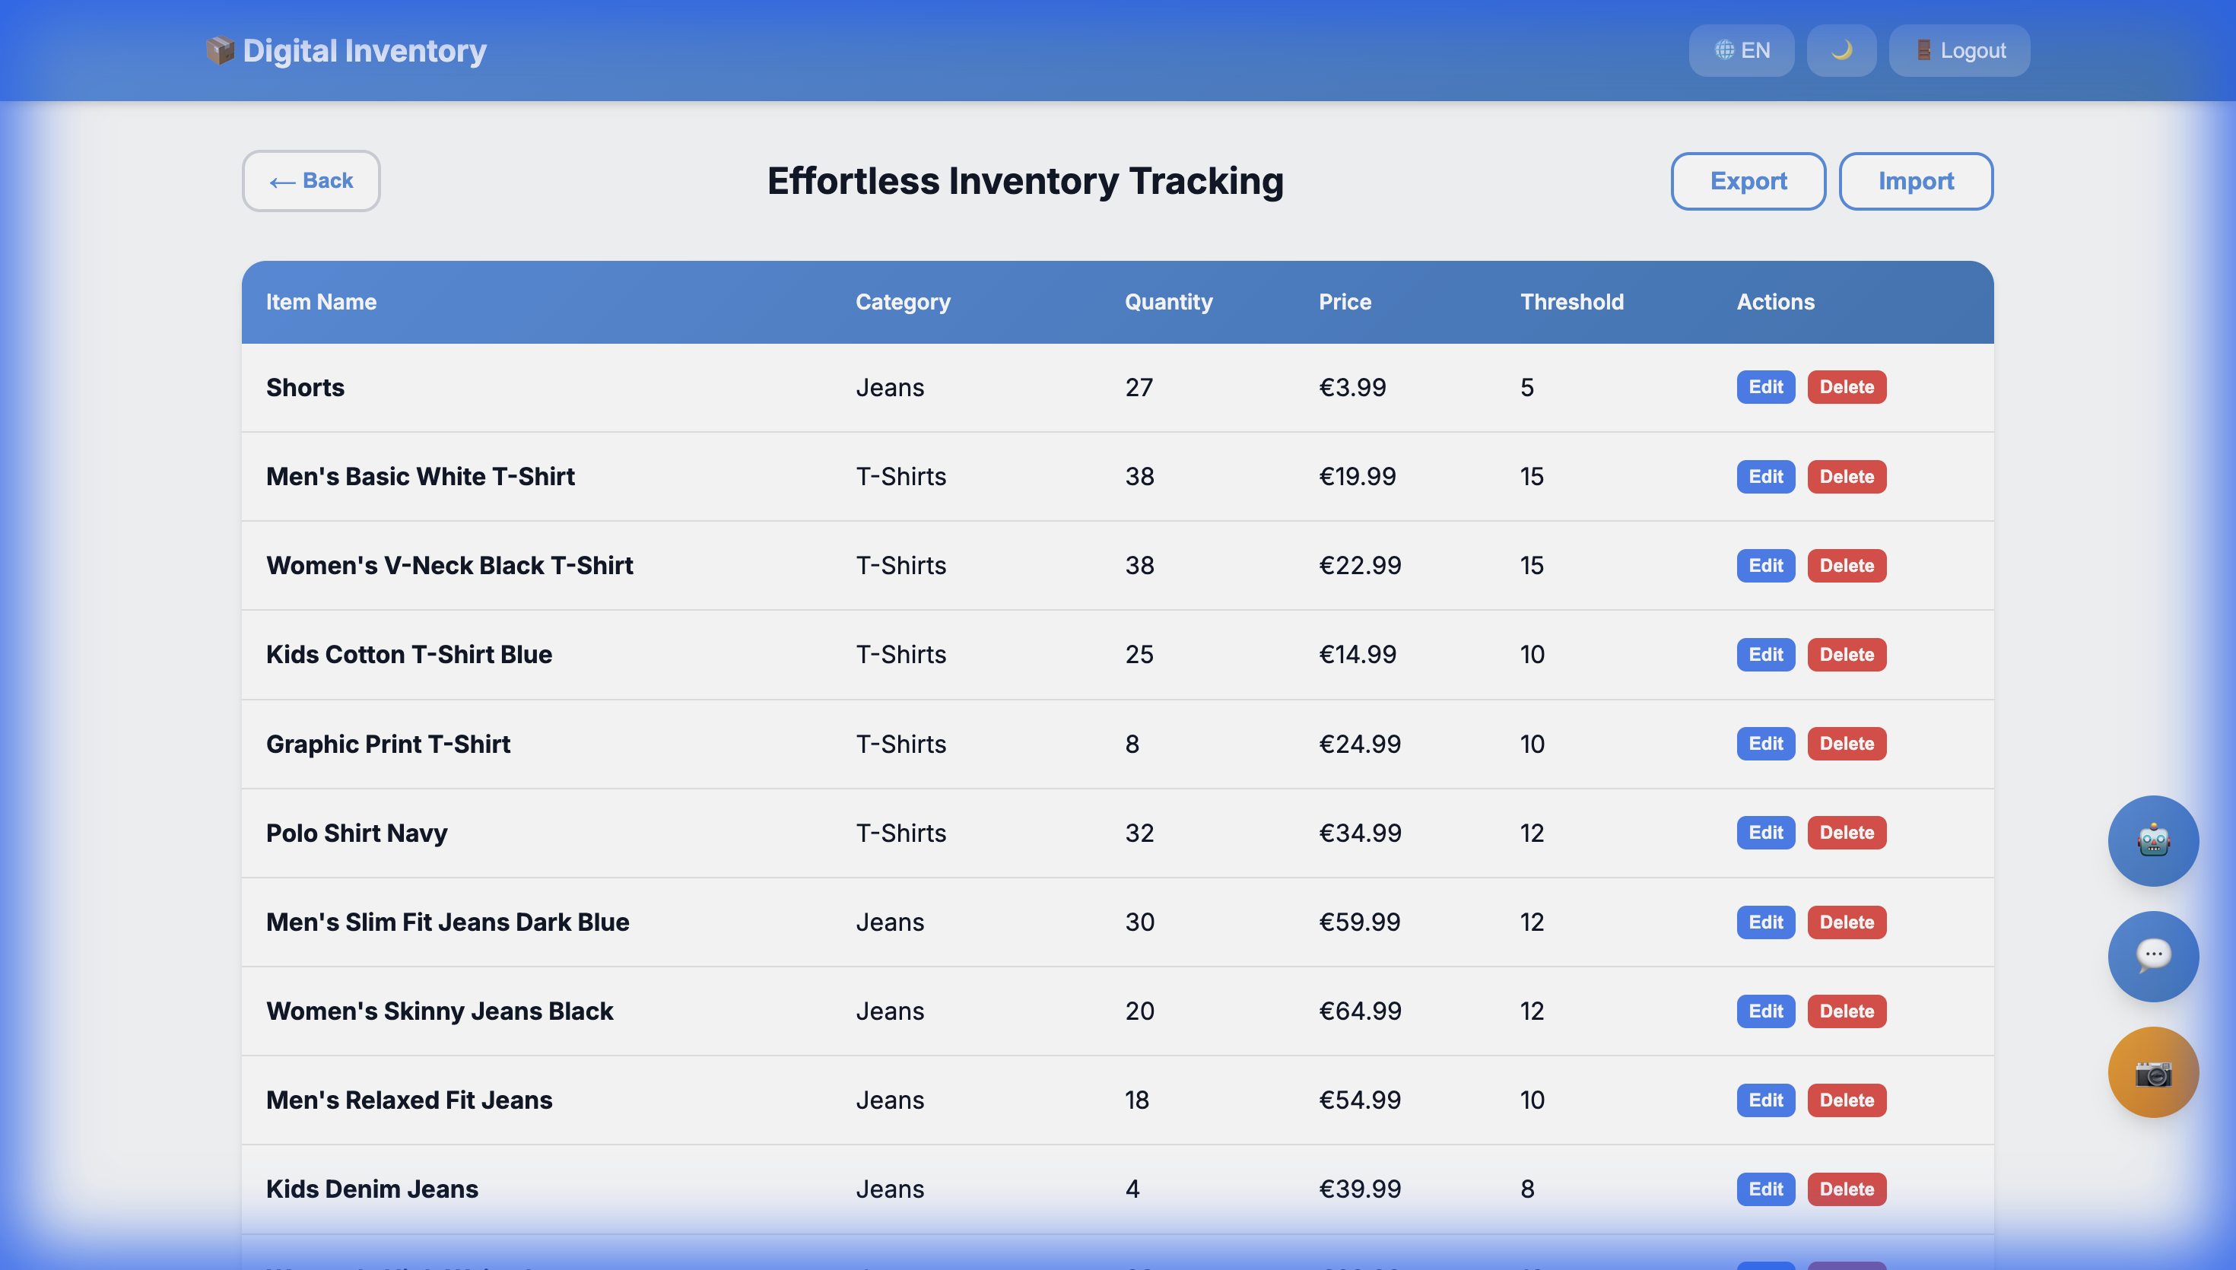
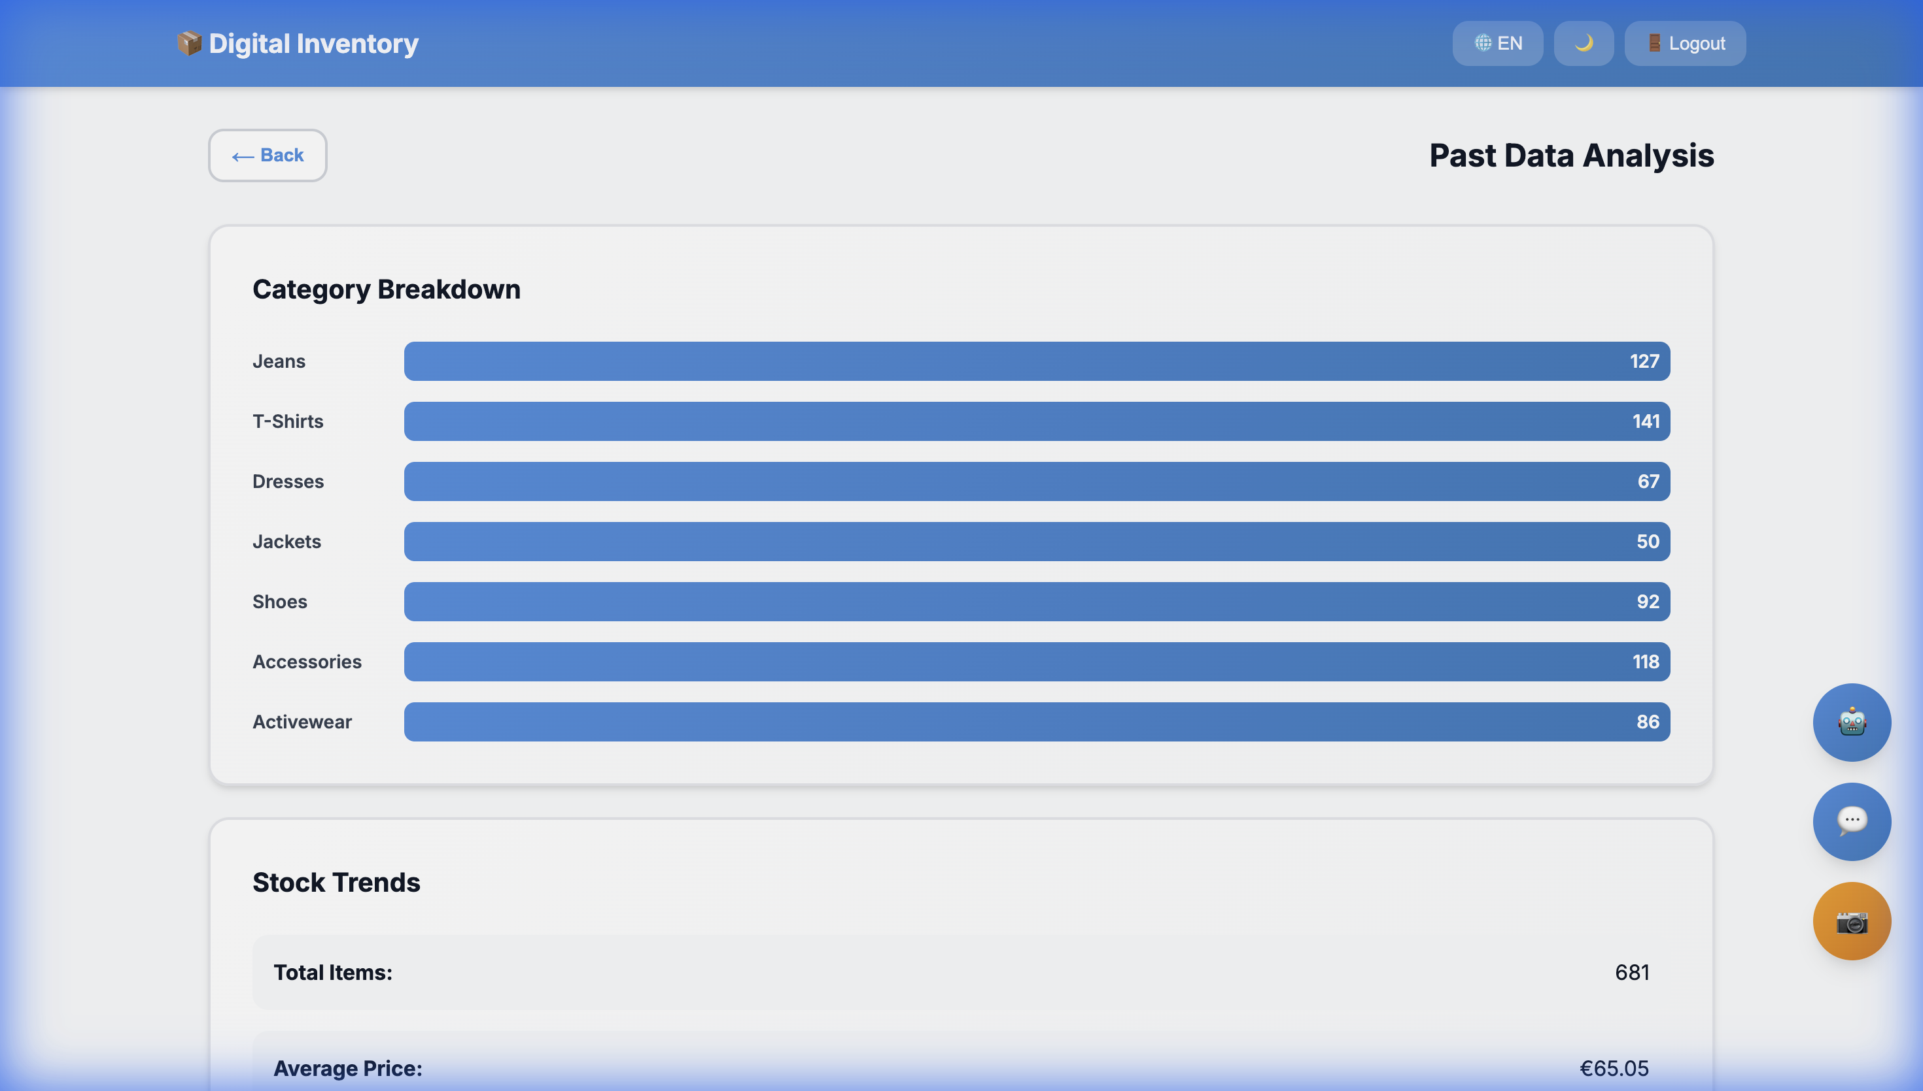
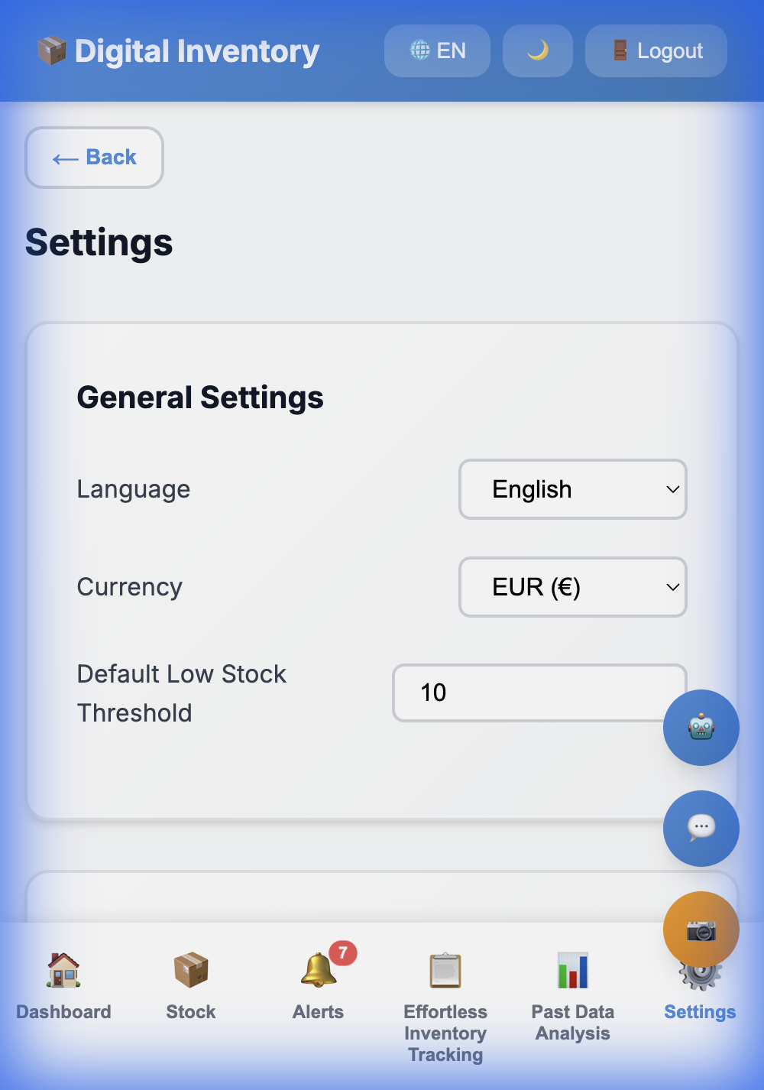
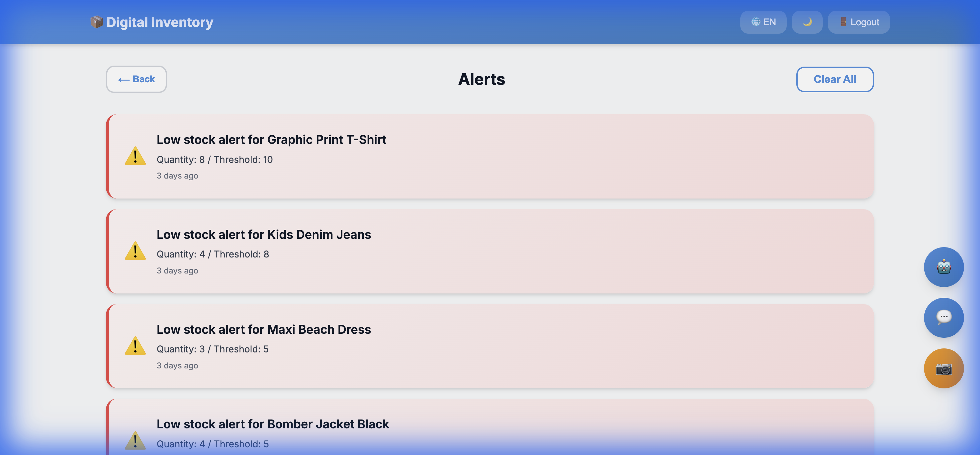
Digital Inventory - Application Screenshots
Dashboard
Stock Level
Inventory
Analytics
Settings
Alerts

